Slide 1
Thales Wex Work Experience
Coding Demonstration

Slide 2
what is programming and what it can do
Programming is a process of creating a list of instructions that a computer can follow to perform a specific task.
What do you think programming can create?

Slide 3
what is programming and what it can do
Programming is a process of creating a list of instructions that a computer can follow to perform a specific task
Websites and applications

Slide 4
what is programming and what it can do
Programming is a process of creating a list of instructions that a computer can follow to perform a specific task
Websites and applications
Data Analysis Tools

Slide 5
what is programming and what it can do
Programming is a process of creating a list of instructions that a computer can follow to perform a specific task
Websites and applications
Data Analysis Tools
Artificial Intelligence and machine learning

Slide 6
what is programming and what it can do
Programming is a process of creating a list of instructions that a computer can follow to perform a specific task
Websites and applications
Data Analysis Tools
Artificial Intelligence and machine learning
Cyber security solutions

Slide 7
what is programming and what it can do
Programming is a process of creating a list of instructions that a computer can follow to perform a specific task
Websites and applications
Data Analysis Tools
Artificial Intelligence and machine learning
Cyber security solutions
Many More

Slide 8
Different types of coding languages what are these used for also their benefits and disadvantages
It has been estimated that there are 14,000 different programming languages each having their own desired purpose and use cases. But there are some more common/Popular Languages.
Can you name the Top 5?
Python
C++
Java
C
C#

Slide 9
Different types of coding languages what are these used for also their benefits and disadvantages
Each Language has its own benefits and areas they preform best
Python: Known for simplicity and versatility. It is known to be used in development in AI, Data science and automation.
C++: known for being high performance which Is system level. Know to be used in Game Engines, Operating systems and embedded systems
Java: known for being cross-platform and object oriented. Known to be used in enterprise software, android apps and back-end systems
C: known for its speed, efficiency. Known to be used in in OS kernels, embedded systems and networking
C#: Known for its abilities in cloud and enterprise ecosystems. Known to be used In Windows apps, Enterprise software and gamed Dev.

Slide 10
Coding language honourable mentions ?
Honarable mentions Java Script, SQL, HTML?

Slide 11

Comments
Comments, Data Tyes, Conditional statements, Loops, Functions
Comments are used to describe sections of code generally used to describe what a section of code is Doing or how it works.
To implement a comment, ensure at the beginning of the comment there is a “#” this makes it, so the interrupter ignores the comment and does not try and run the line. For example, Figure A.
Figure A: Show a section of code. For preset Audio function

Slide 12
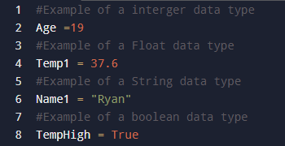
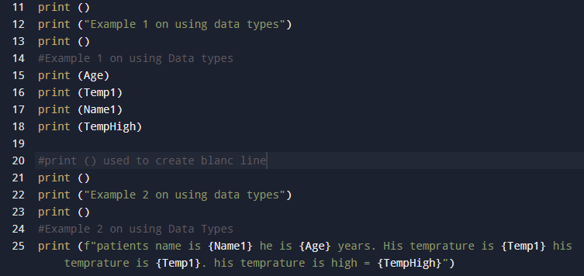
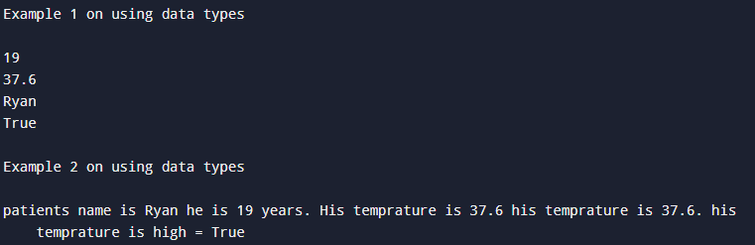
Variables and Data Types
Data Types
Integer = Whole Number = 9
Float = Decimal Number = 15.3
String = more than 1 alphabetical character = Team
Boolean = True or False = True
Figure A: Shows how to input each Data type
Figure c: Shows the output from Figure B. Showing 2 examples of data types being used
Figure B: code using all 4 Datatypes

Slide 13
Loops
Loops and how to create them

Slide 14
Functions
Functions and how to create then

Slide 15
Project Code review
Going over the code base that was created Robot Programing 1.1

Slide 16
Basic code for robot
Going over the bare basics on programming the robot

Slide 17
Demonstrating how to use the Knowledge base
Demonstrate how to use the lego spike knowledge base

